Slide 1
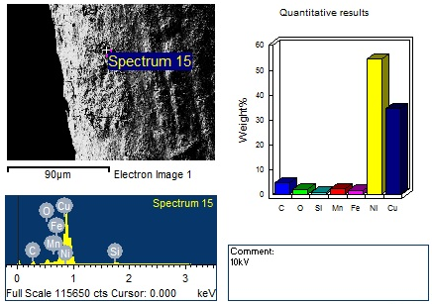
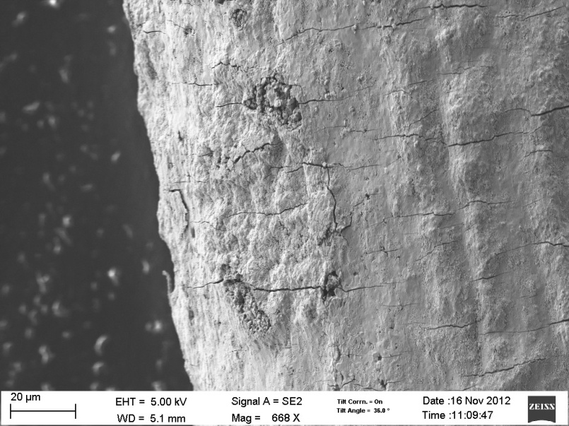
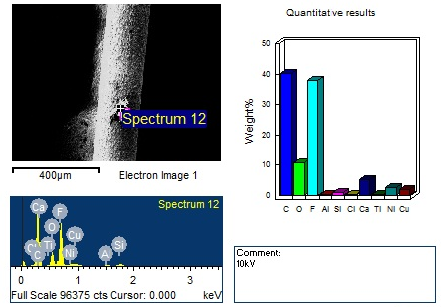
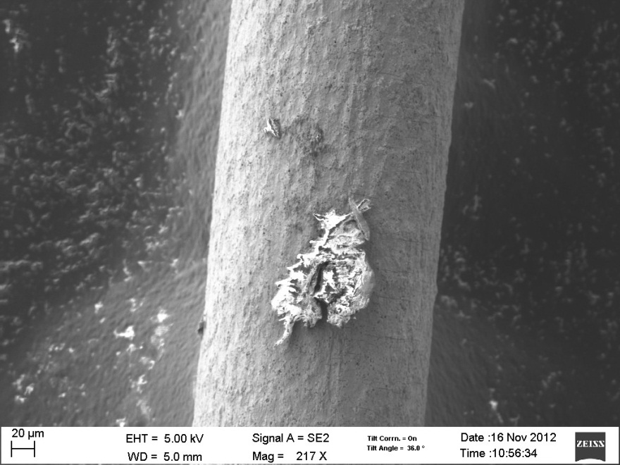
Analisi del filo con 2 strati
XYZ
Big International Company
Notes:
<number>

Slide 2
<number>
Potenza prodotta
XYZ
Wire 55 mg mass 20 cm lenght
0,2 mm diameter
Usual experiment five times larger
Temp. Extra Power
56°C 0
75°C 0
100°C 0
125°C 0
150°C 0
175°C 28 mW
200°C 72 mW
250°C 249 mW
300°C 600 mW
350°C 1.16 W
Big International Company

